Slide 1
Biology 1
Diffusion & Osmosis Lab

Slide 2
Background Information
Cell Membranes are described as semi-permeable
What does this mean?
Semi-permeable: only certain materials can enter or exit the cell

Slide 3
Background Information
Most items enter the cell by a process called diffusion
What is diffusion?
Diffusion: movement of materials from an area of high concentration to an area of lower concentration
The movement is random
This movement requires no extra energy from the cell
Q: What type of transport would this be and why?
A: Passive transport because the cell does not have spend any extra energy

Slide 4
Background Information
The movement would be passive transport because the cell is not using extra energy
Passive transport of water across a cell membrane is called osmosis
Sometimes items that are dissolved in the water will be able to move across the membrane along with the water as well

Slide 5
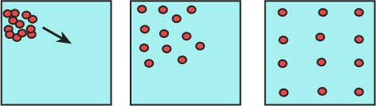
Background Information
What is a concentration gradient?
Concentration gradient: difference between concentrations in a given space

Slide 6

Background Information
Think of a concentration gradient like a hill.
Once the ball starts going down the hill, the person does not have to use any energy to keep it moving.
This is similar to passive transport when the material is moving DOWN a concentration gradient, going from an area of high concentration to an area of lower concentration.
What would the opposite be?

Slide 7

Background Information
Will this person use energy to get the ball up the hill?
This would like going UP a concentration gradient. The material would flow from an area of lower concentration to an area of higher concentration. It is not a natural flow…..therefore it takes some energy to get this done.
This would be an example of ACTIVE TRANSPORT. Extra cellular energy is required for active transport.

Slide 8
Lab Objectives
Our lab will demonstrate:
1. the diffusion of materials across a membrane
2. osmosis of water across a membrane
3. limits of diffusion of a substance based on the size of the particles in the substance

Slide 9
Upon Completion of Today’s Lab
You will be able to:
1. identify which materials were able to cross the membrane, and in which direction they went
2. identify which materials were not able to cross the membrane and explain why

Slide 10
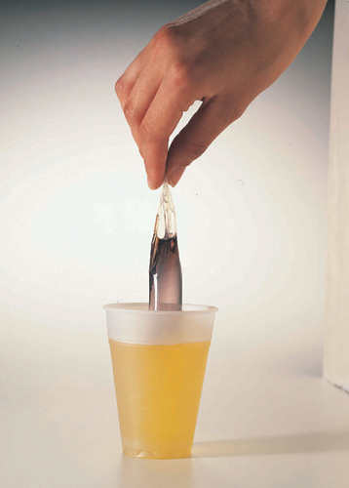
Did your final results look like this?
Inside the membrane tube should indicate a presence of starch by turning purplish-black.
And the membrane tube should be slightly fuller than when you began. This indicates that water also moved into the membrane.

Slide 11
Lab Follow-Up
What substances were able to cross the membrane:
Lugol’s solution went from the cup into the membrane tube
Glucose went from the membrane tube into the cup
Water went from the cup into the tube

Slide 12
Lab Follow-Up
How do you know the substances moved or not?
Glucose moved from inside the membrane tube because the water in the cup should have tested positive for glucose at the end of the lab (and you didn’t put glucose in the cup at the beginning, so it had to come from the membrane tube)
Lugol’s solution moved from the cup, across the membrane and into the tube because it reacted with the starch in the tube and turned a dark purple or black color
Lugol’s solution does not react with glucose……if it did, the color of the cup water would have turned all black at the end of the lab, and it didn’t
Water moved across the membrane and into the tube……you know this because the tube is slightly fuller at the end of the lab than when you started the lab

Slide 13
Lab Follow-Up
What substance did not pass across the membrane and stayed right where you put it?
Starch
How do you know this?
If the starch would have moved into the cup, the contents of the cup would have turned dark purple or black in color……and at the end of the lab the cup was the same color as when you started
Why doesn’t starch move across the membrane?
Starch is polymer which means it’s a very large molecule and the tiny pores in the membrane are too small to allow starch to leak out of the membrane

Slide 14
Lab Follow-Up
How do you know starch did not pass across the membrane?
What color would this be if starch would have come out of the membrane tube and into the cup?

Slide 15
Click on the video below to get a better understanding of what was accomplished during today’s lab:
Dialysis Tube Experiment
AP Biology Diffusion & Osmosis Lab

